Slide 1
Feature options (What you will build)

Slide 2
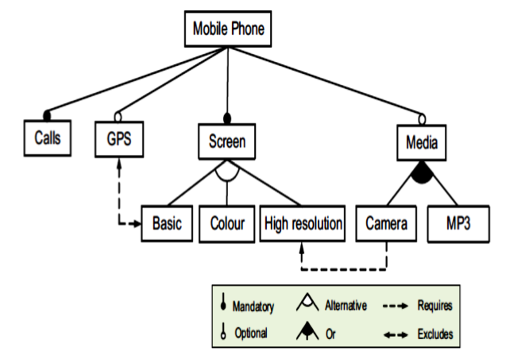
Example #2: Feature maps
Design product line [Kang’90]
Add in known constraints
E.g. “if we use a camera then we need a high resolution screen”.
Extract products
Find subsets of the product lines that satisfy constraints.
If no constraints, linear time
Otherwise, can defeat state-of-the-art optimizers [Pohl et at, ASE’09] [Sayyad, Menzies ICSE’13].
Cross-Tree
Constraints

Slide 3
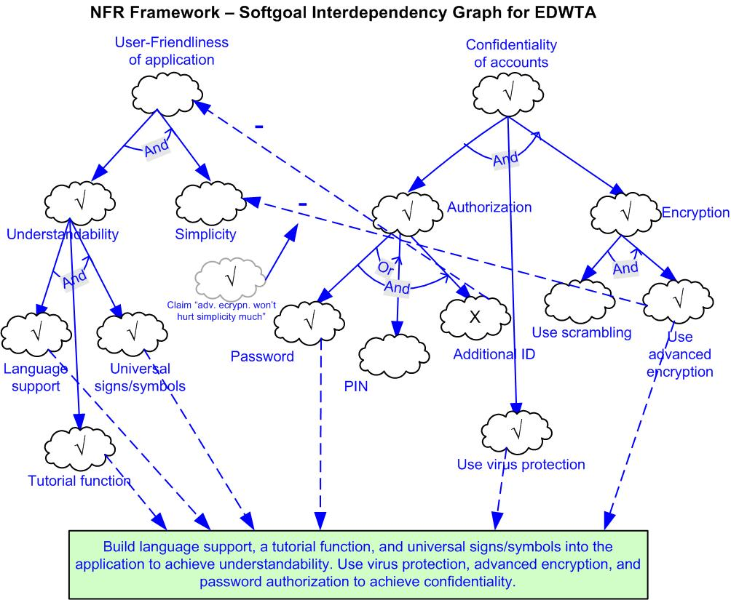

Slide 5
Trade off options (What you will not build)

Slide 6
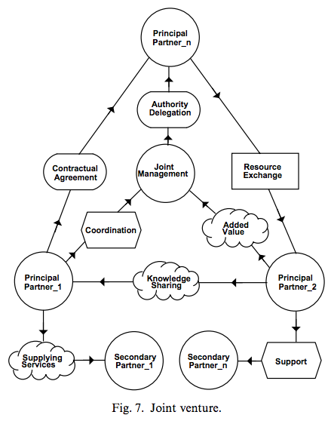
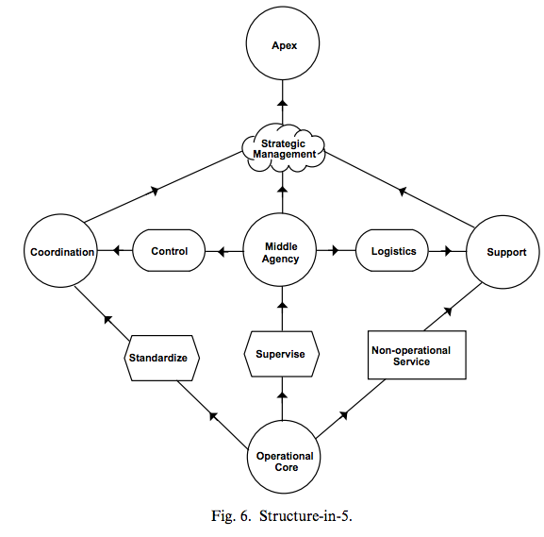
Is there more than one design?

Slide 7
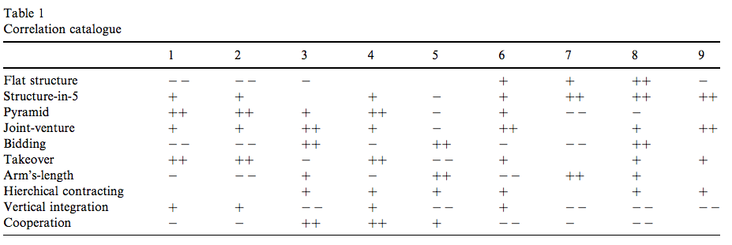
Is there more than one design?
Assessing options of criteria
predictability (1), security (2), adaptability (3), coordinability (4), cooperativity (5), availability (6), integrity (7), modularity (8), or aggregability (9)
Which is best? Dunno. Ask your stakeholders!
But add value to their discussions
Give them considered conclusions to aid their decisions

Slide 8
Process options (How you will build it)

Slide 9
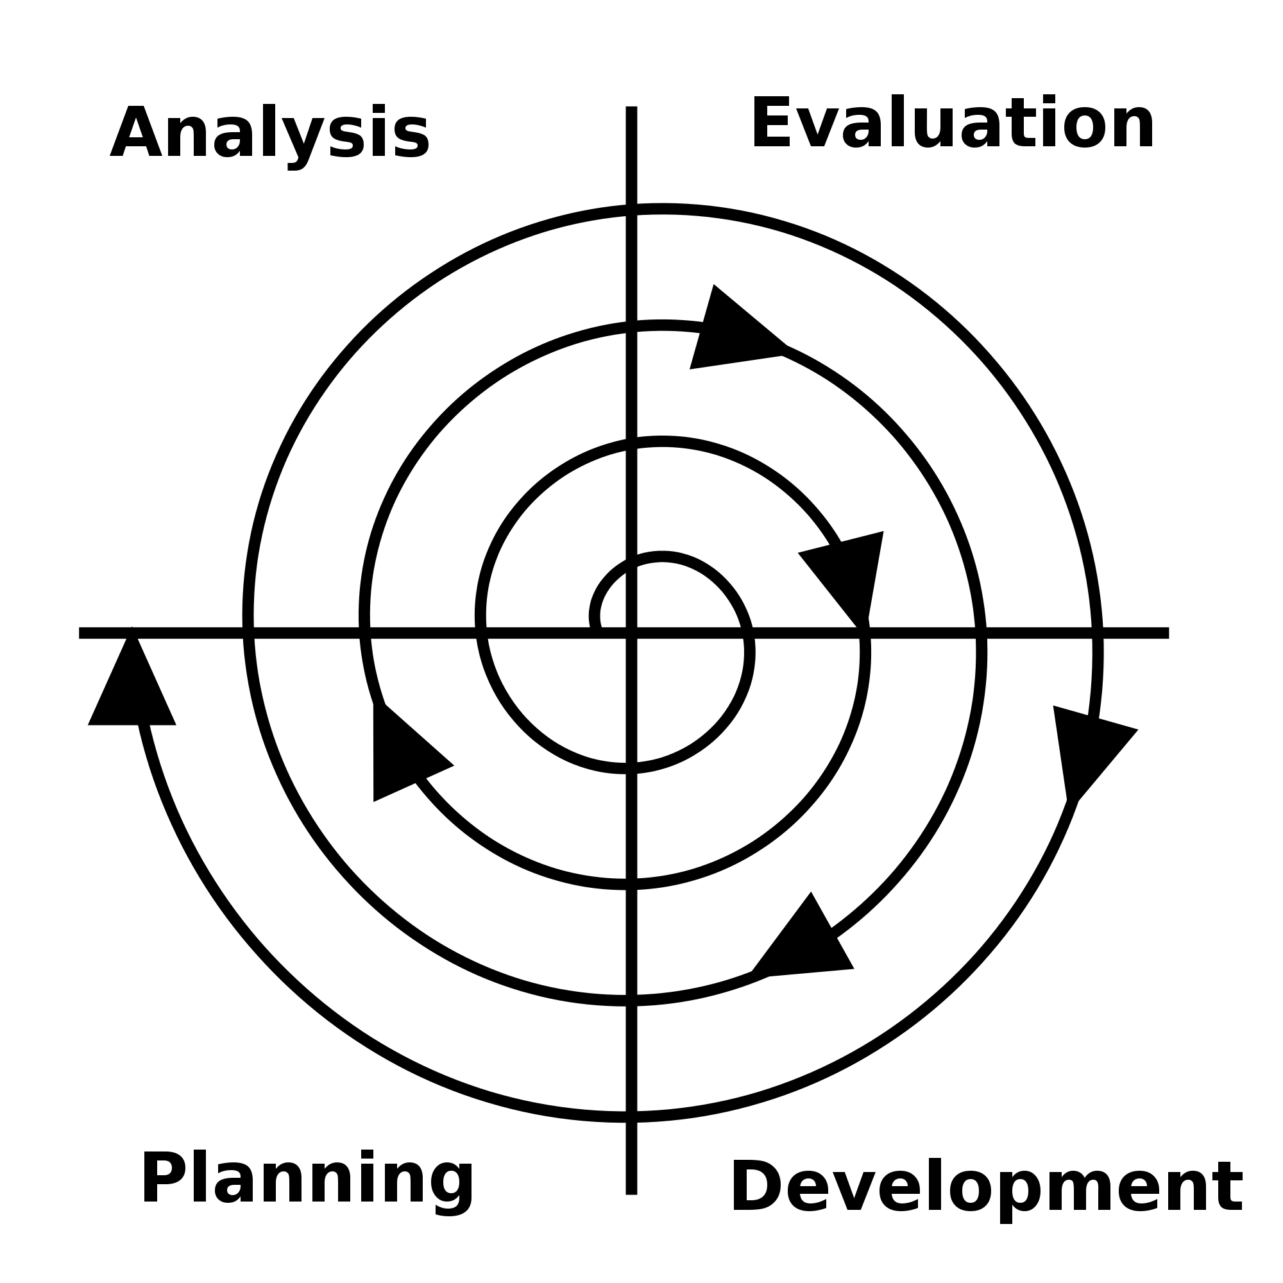
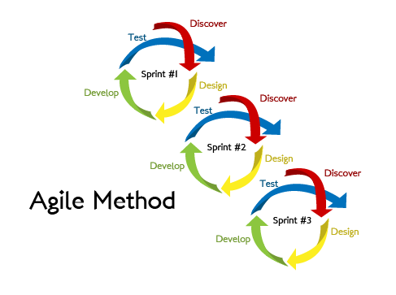
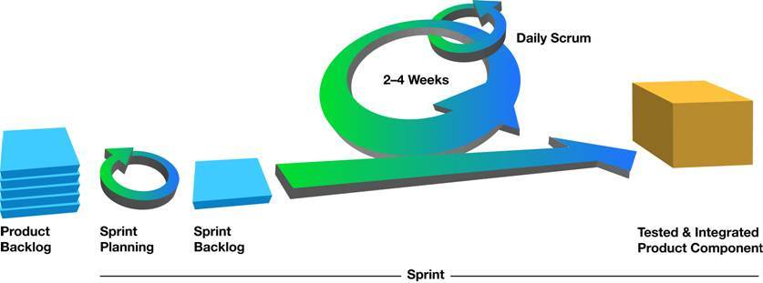
BTW: Connection Spiral to Agile
Spiral: a few iterations before waterfall
Agile: small iterations before more small iterations
Value for BIG engineering projects?

Slide 10
Architecture
MVC,
Message passage
Publish subscribe
Etc
Etc
etc

Slide 11
Stakeholder options (who are you building for?)

Slide 12
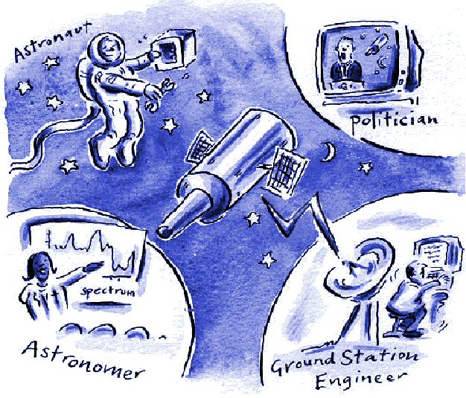
Stakeholders, examples: Do all these folks want the same thing?

Slide 13
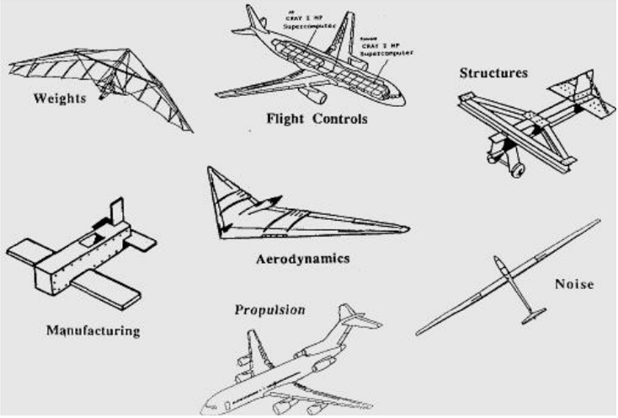
Stakeholders, examples: “one” thing is “many” things, depending on stakeholder perspective.

Slide 14
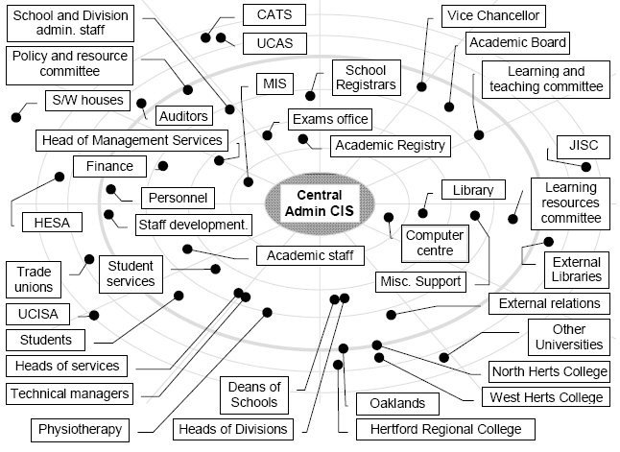
Stakeholders, examples: Do all these folks want the same thing?

Slide 15
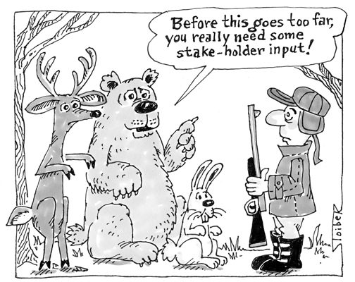
Stakeholders, examples: Do all these folks want the same thing?

Slide 16
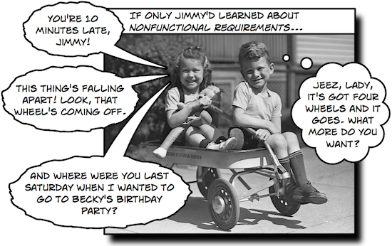
Stakeholders have different “non-functional requirements”
Time
• Transactions / sec
• Response time
• Time to complete an operation
Space
• Main memory
• Auxiliary memory
• (Cache)
Usability
• Training time
• Number of choices
• Mouse clicks
Reliability
• Mean time to failure
• Downtime probability
• Failure rate
• Availability
Robustness
• Time to recovery
• % of incidents leading to catastrophic failures
• Odds data corruption after failure
Portability
• % of non-portable code
• Runs on N operating systems
• Runs on desktop, tablet, mobile
Etc

